Slide 1
Proposal Presentation XLNet: Generalized Autoregressive Pretraining for Language Understanding
Reporter: Tianyu Hua, Xuan Chen
Student # , Student #82286956
Original paper

Slide 2
Problems being solved
Related work
Contributions
Dataset
Experiments
Evaluation metrics
Group member & timeline

Slide 3
Problems being solved
Relying on corrupting the input with masks, BERT neglects dependency between the masked positions and suffers from a pretrain-finetune discrepancy.
Enables learning bidirectional contexts by maximizing the expected likelihood over all permutations of the factorization order.
Overcomes the limitations of BERT thanks to its autoregressive formulation.

Slide 4
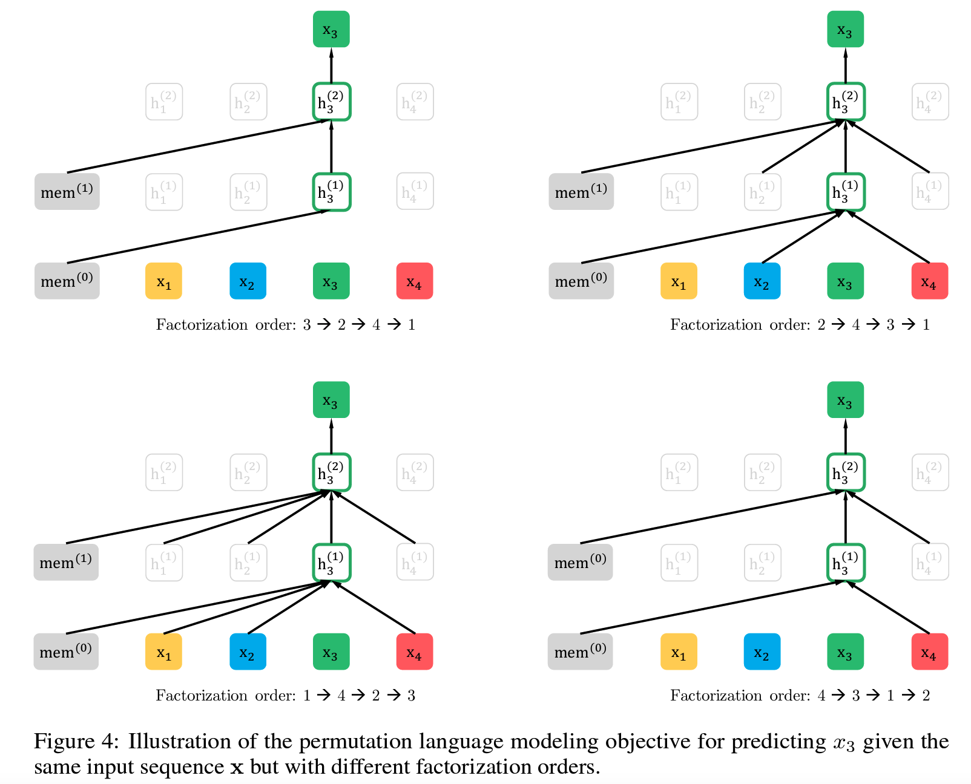
Related work
Permutation Language Modeling

Slide 5
Related work
Autoregressive (AR) model and autoencoding (AE) model.
BERT pretrains on masked language modeling and next sentence prediction tasks, while GPT-2 pretrains on language modeling tasks.
XLNet uses a permutation-based training approach that allows the model to capture dependencies between all positions in the input sequence without being biased towards a specific direction.
The model predicts the probability of a word at a specific position in the sequence given all other words in the sequence, regardless of their order.

Slide 6
Contributions of paper
Instead of using a fixed order of forward or reverse as input as in traditional AR models, XLNet maximizes expectation of all permutations from input sequence.
As a generic AR language model, XLNet no longer uses data corruption, and eliminates the independence assumption in BERT.
XLNet applies segment recurrence in Transformer-XL and the relative encoding scheme to pretraining, whose performance is proved to be particularly significant on long text sequences.
Transformer(-XL) network is reparametrized to reduce the uncertainty.

Slide 7
Our expected contributions

Slide 8
Dataset

Slide 9
Experiments

Slide 10
Evaluation Metrics

Slide 11
Timeline and members
Timeline
14/2 - 15/2: Project discussion
20/2 – 1/3: Project proposal presentation and written proposal
6/3 – 13/3: Experiment and adjust model
15/3 – 27/3: Final project presentation preparation
29/3 – 8/4: Final project report
Division of tasks of members
Tianyu Hua:
Xuan Chen: research the original paper, analyze model architecture, and process dataset.

